Slide 1
Pandas.Series module 2
Note to other teachers and users of these slides. Feel free to use or modify these slides as you wish. If you use a significant portion of these slides in your own lecture, please include this message, or the following link to the source repository of Michele’s lectures on github:
https://github.com/samorani. Comments and corrections are welcome.

Slide 2
This course
Visualization packages
Matplotlib /
Seaborn
scikitlearn
Machine learning package
pandas
Data structures package
numpy
TODAY
Computation package
Python
Language, syntax

Slide 3
Numpy – In a slide
It is a module that provides:
ndarray: a wrapper for Python arrays
dtype: a wrapper for Python types
Pandas is built on top of numpy. Therefore:
Occasionally, pandas functions return arrays – they will be ndarray
Data Types in pandas (int, float, date, …) are dtype
Today, we will see just a bit of numpy
We will see more in the machine learning part

Slide 4
This course
Visualization packages
Matplotlib /
Seaborn
scikitlearn
Machine learning package
STARTING TODAY
pandas
Data structures package
numpy
Computation package
Python
Language, syntax

Slide 5
Pandas– Overview
It is the module that provides data structures and methods for data manipulation. Examples
Load a table from a csv file
Find the rows that satisfy a condition
Create a new calculated column
Group by
Merge tables
Remove null values
Replace YES with 1 and NO with 0

Slide 6
Set up
Download the following files into the same directory:
module 02 -- pandas.Series.ipynb
students.csv
OPEN module 02 -- pandas.Series.ipynb

Slide 7
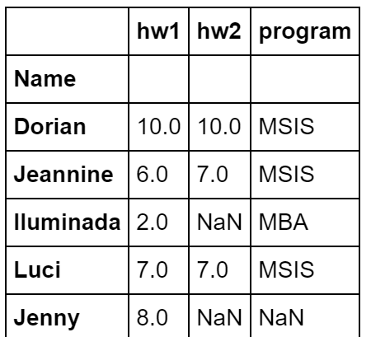
Today’s data set
students.csv:
One student per row
Columns: hw1 (the grade received on hw1), hw2 (the grade received on hw2), and program.

Slide 8
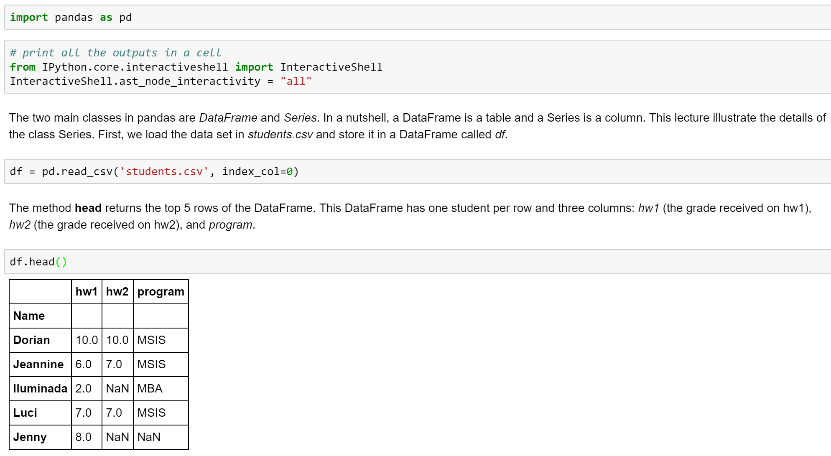
Loading the data set

Slide 9
Series

Slide 10
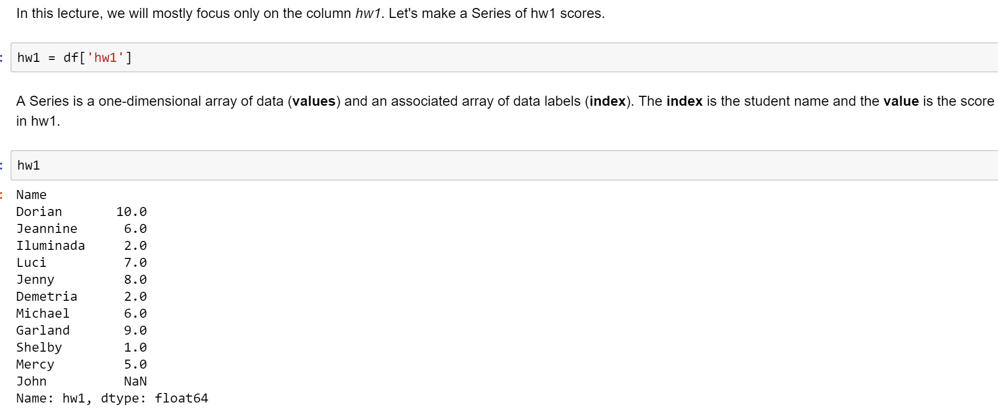
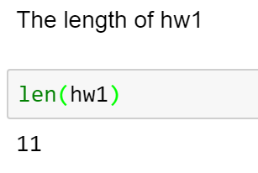
hw1 Series

Slide 11
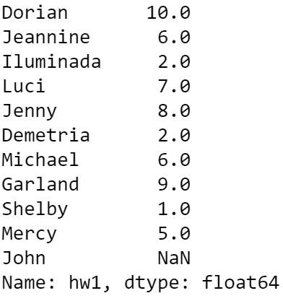
INDEX
POSITIONAL INDEX
VALUES
0
1
2
3
4
5
6
7
8
9
10

Slide 12
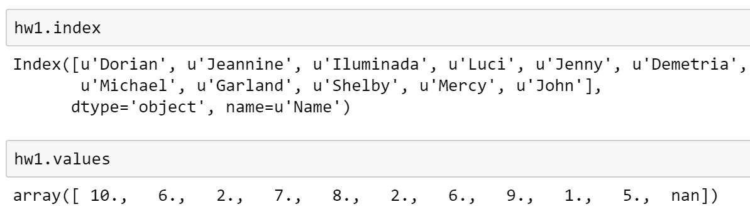
Index and values
INDEX
POSITIONAL INDEX
VALUES
Return the index (as an index object) and the values
Example:
0
1
2
3
4
5
6
7
8
9
10
ndarray

Slide 13
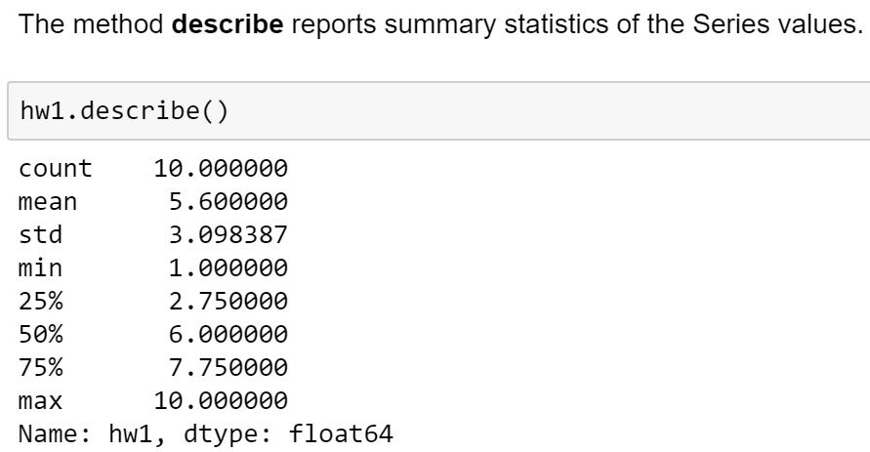
describe
INDEX
POSITIONAL INDEX
VALUES
0
1
2
3
4
5
6
7
8
9
10
10 non-null values

Slide 14
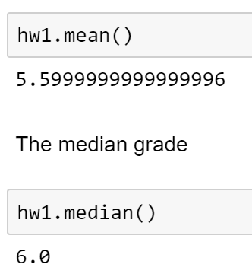
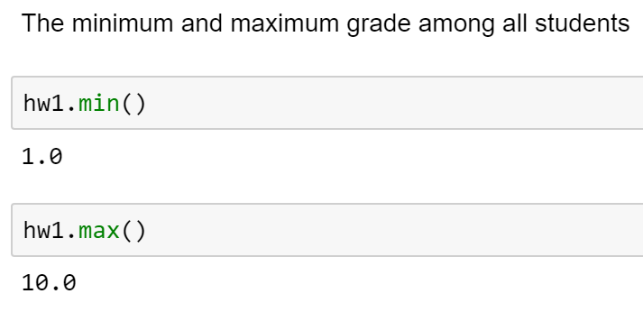
Aggregate Functions
INDEX
POSITIONAL INDEX
VALUES
Mean, sum, abs, cumsum, etc
Example:
0
1
2
3
4
5
6
7
8
9
10

Slide 15
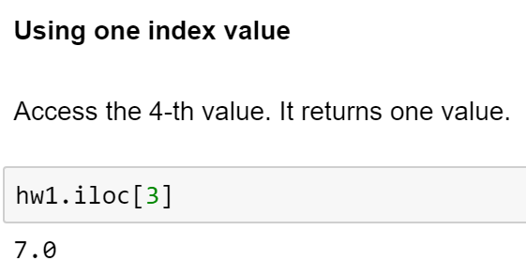
iloc (using a single integer)
INDEX
POSITIONAL INDEX
VALUES
0
1
2
3
4
5
6
7
8
9
10

Slide 16
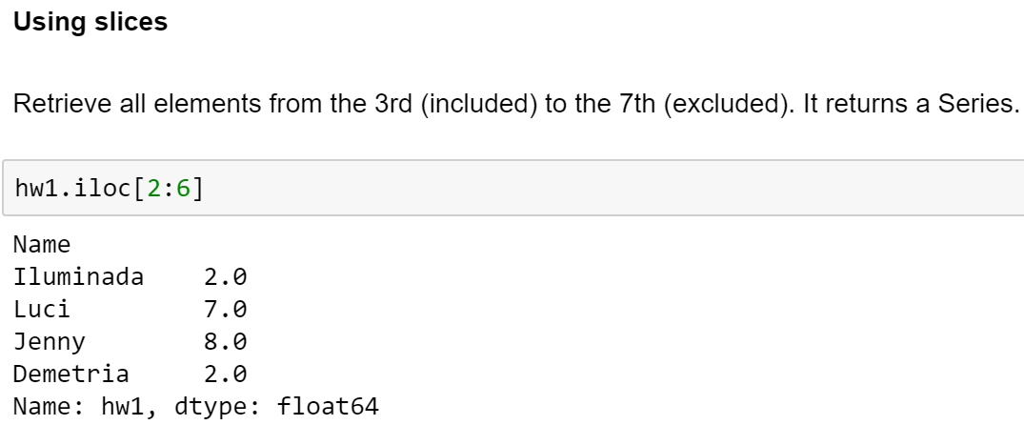

iloc (using a slice of integers)
INDEX
POSITIONAL INDEX
VALUES
0
1
2
3
4
5
6
7
8
9
10

Slide 17
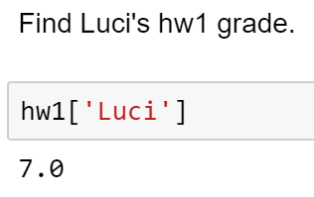
Index-based selection: a single label value
INDEX
POSITIONAL INDEX
VALUES
0
1
2
3
4
5
6
7
8
9
10

Slide 18
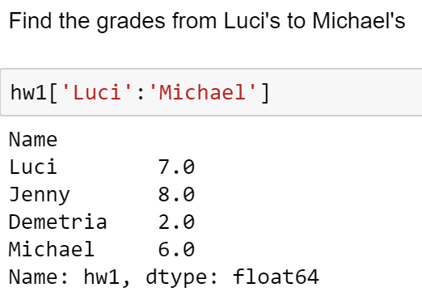
Index-based selection: a slice of index labels
INDEX
POSITIONAL INDEX
VALUES
0
1
2
3
4
5
6
7
8
9
10

Slide 19
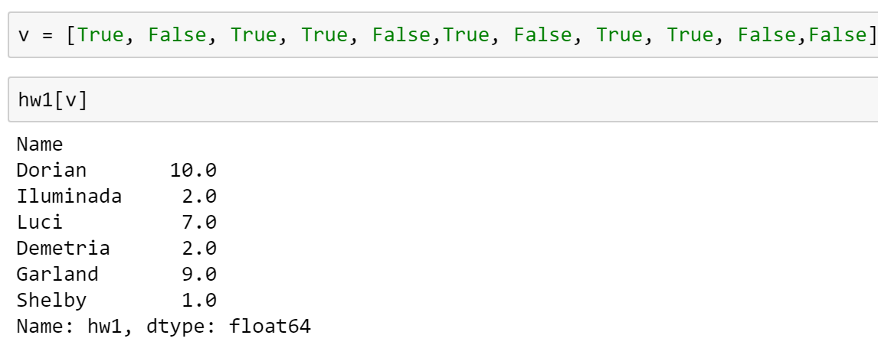
Index-based selection: a sequence of Booleans
INDEX
POSITIONAL INDEX
VALUES
0
1
2
3
4
5
6
7
8
9
10

Slide 20
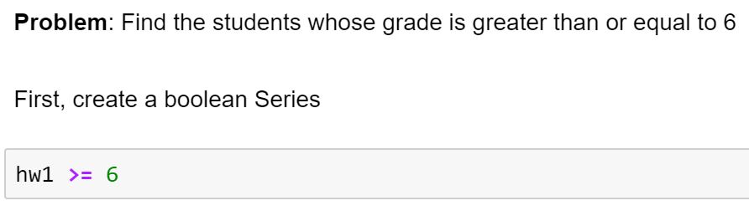
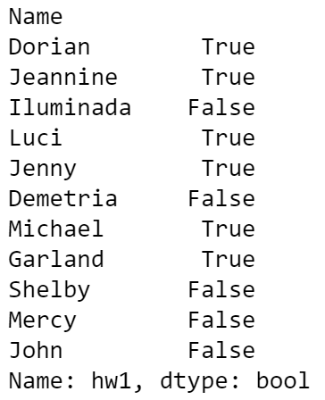
Boolean Selection (1/2)
INDEX
POSITIONAL INDEX
VALUES
Creates a filter (or mask) that selects those rows whose value satisfy a condition
Example:
0
1
2
3
4
5
6
7
8
9
10
All rows whose value is >= 6

Slide 21
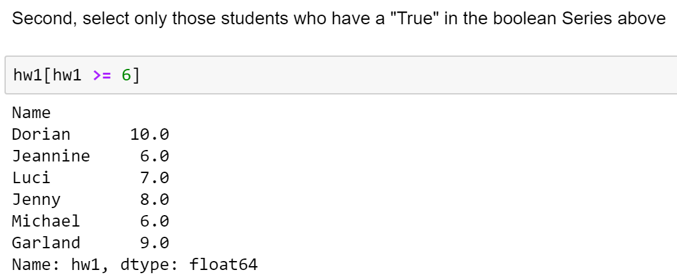
Boolean Selection (2/2)
INDEX
POSITIONAL INDEX
VALUES
Creates a filter (or mask) that selects those rows whose value satisfy a condition
Example:
0
1
2
3
4
5
6
7
8
9
10

Slide 22
Problems in class
What’s Michael’s hw1 score?
Select the “last” student of the Series (i.e., the one reported last). Make sure to retrieve both the name and the grade.
Compute the average hw1 grade among those students whose grade is less than or equal to 6
(together) Select those students whose hw1 score is less than 5 or greater than 9

Slide 23
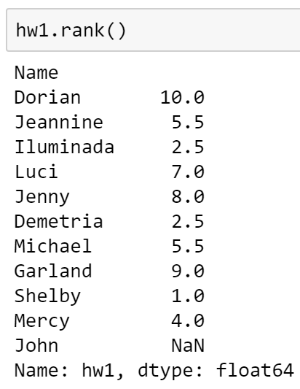
rank()
INDEX
POSITIONAL INDEX
VALUES
Ranks each row based on the value
Example:
0
1
2
3
4
5
6
7
8
9
10
Notice any problem?

Slide 24
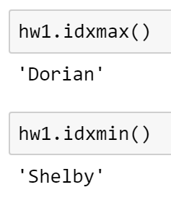
idxmax() and idxmin()
INDEX
POSITIONAL INDEX
VALUES
Find the index of the row with maximum and minimum values
Example:
0
1
2
3
4
5
6
7
8
9
10

Slide 25
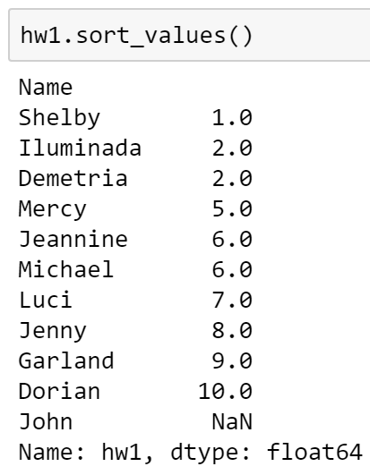
sort_values()
INDEX
POSITIONAL INDEX
VALUES
Sort by values
Example:
0
1
2
3
4
5
6
7
8
9
10

Slide 26
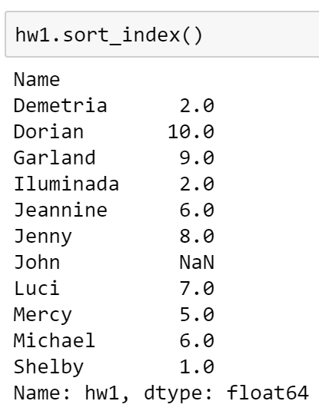
sort_index()
INDEX
POSITIONAL INDEX
VALUES
Sort by index
Example:
0
1
2
3
4
5
6
7
8
9
10

Slide 27
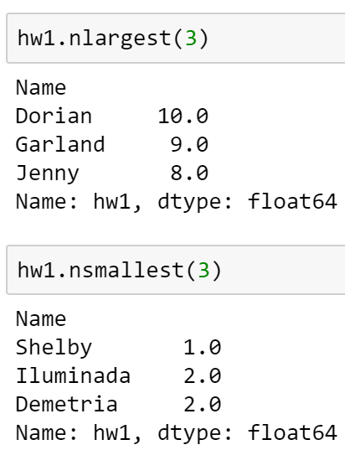
nlargest(n) and nsmallest(n)
INDEX
POSITIONAL INDEX
VALUES
Finds the n items with largest or smallest value
Example:
0
1
2
3
4
5
6
7
8
9
10

Slide 28
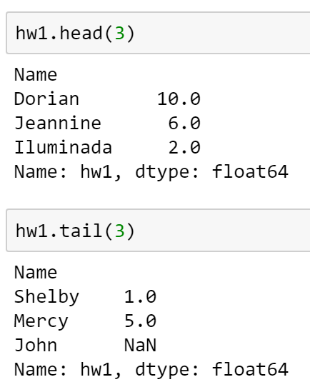
head(n) and tail(n)
INDEX
POSITIONAL INDEX
VALUES
Returns the first (or last) rows according to the positional index
Example:
0
1
2
3
4
5
6
7
8
9
10

Slide 29
Problems in class
Explore the parameters of the method "rank" to solve this question. Find the rank of each student (1=best, 10=worst) and deal with ties in the way that makes most sense to you.
Who got the 4th highest grade?
Retrieve the row of the person who comes last in alphabetical order.
Among those students whose name starts with ‘J’, who got the highest grade?

Slide 30
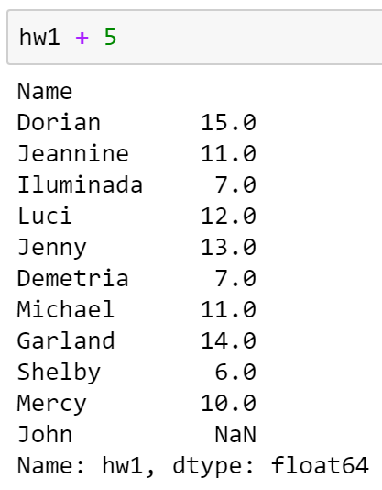
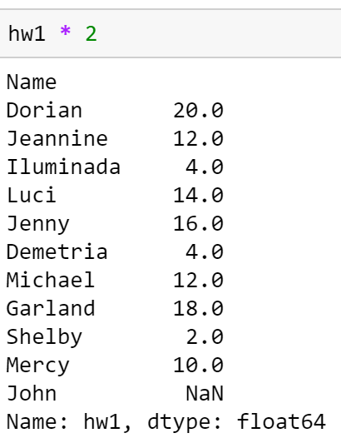
Operations between a scalar and a Series
INDEX
Performed element-by-element
Example:
POSITIONAL INDEX
VALUES
0
1
2
3
4
5
6
7
8
9
10

Slide 31
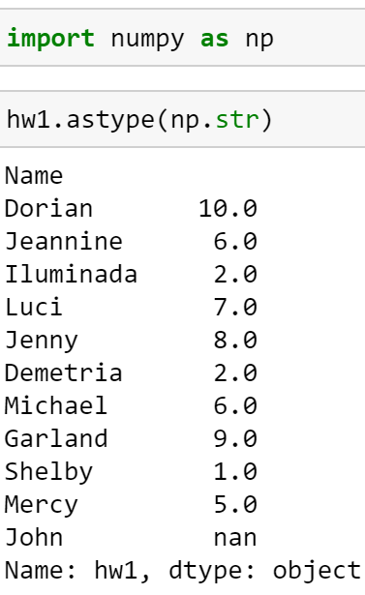
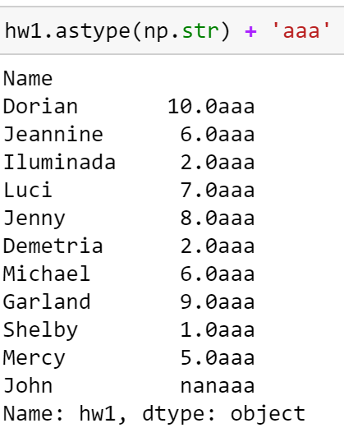
astype: Convert the values of a Series
Sometimes it is useful to convert a series to another type. For instance, convert a numeric series into a series of strings (np.str) or convert a series of text into dates (np.datetime64). Here is how to convert a Series of floats to a Series of string.
INDEX
VALUES
POSITIONAL INDEX
0
1
2
3
4
5
6
7
8
9
10

Slide 32
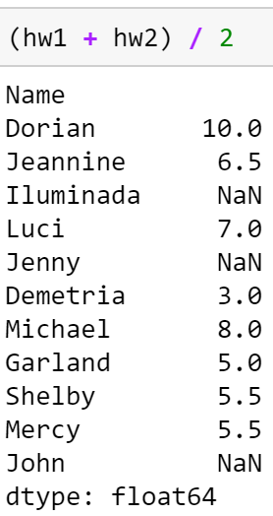
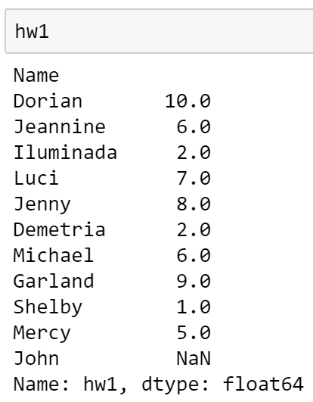
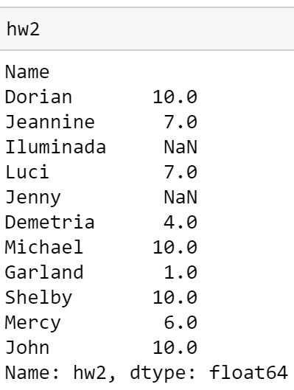
Operations between two Series
Performed between elements with the same index. May result in NaN
Example:
Students have taken hw2. But some of them have dropped out right after taking hw1
Compute the average between the two hws

Slide 33
Problems in class
The average grade of hw1 is too low. We want to normalize it to 8. To this end, increase everyone’s grade so that the new average is 8. Note that some students’ grade might become greater than 10 – don’t worry about it.
Compute the average grade of each student between hw1 and hw2. Which student has the average closest to 6.7?
(solutions on notebook)

